Slide 1


Slide 2
Geometry

Slide 3
Introduction
Geometry is a branch of mathematics that deals with the study of shapes, sizes, relative positions of figures, and the properties of space.
It's a fundamental part of mathematics with applications in various fields including engineering, architecture, art, physics, and even computer graphics.

Slide 4

Polygon
Closed figure of 3 or more sides.
The term "polygon" comes from Greek, where "poly" means "many" and "gon" means "angles" or "sides." Therefore, a polygon is a shape with many angles or sides.

Slide 5



Regular Polygon
All interior angles are equal.
All exterior angles are equal.
The sum of the exterior angles is always 360°.
Sum of interior of a polygon = (2n - 4) * 90

Slide 6
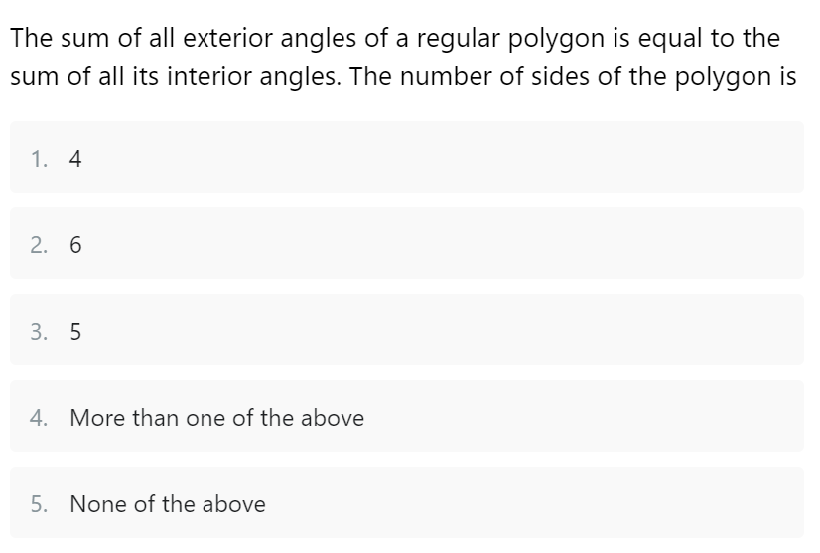
Question
Notes:
Ans : 1) 4

Slide 7
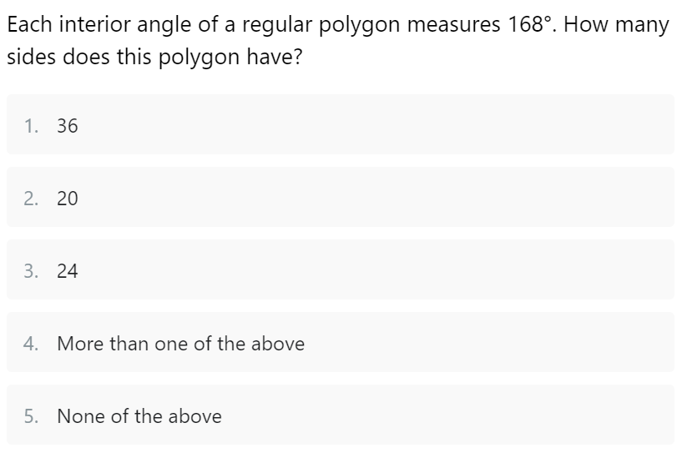
Question
Question
Notes:
Ans: 5) None of the above

Slide 8
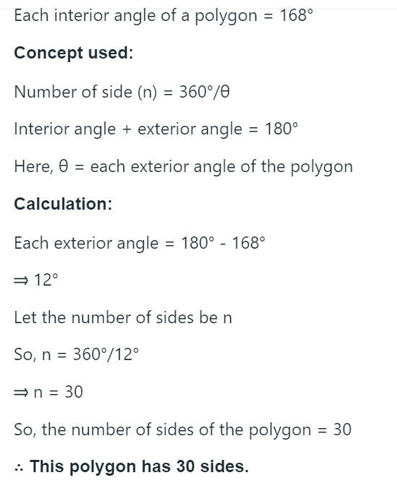
Answer

Slide 9
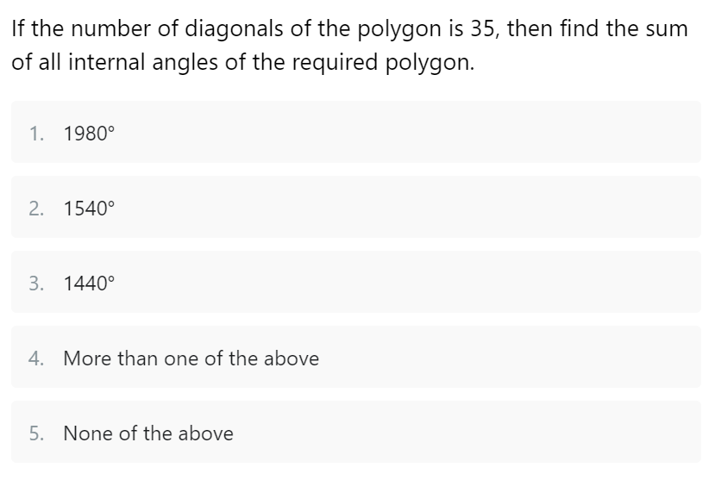
Question
Notes:
Ans: 3) 1440

Slide 10
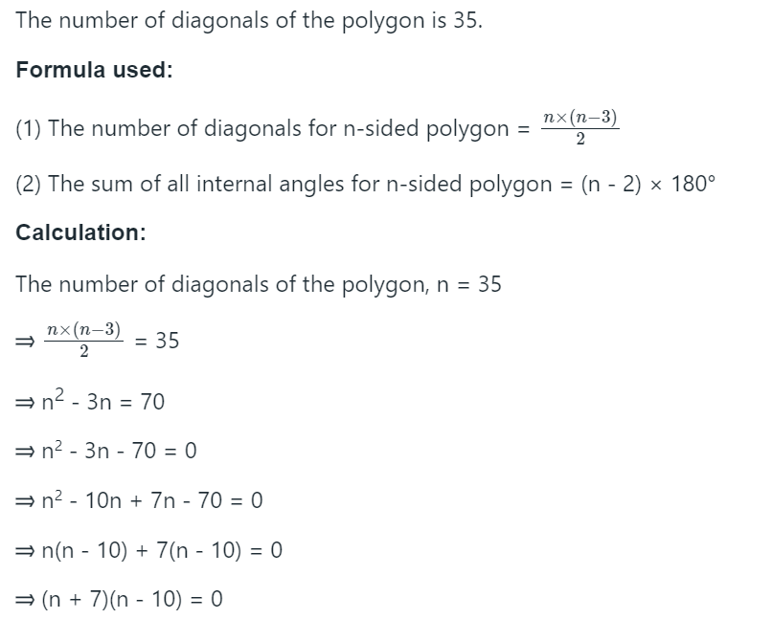
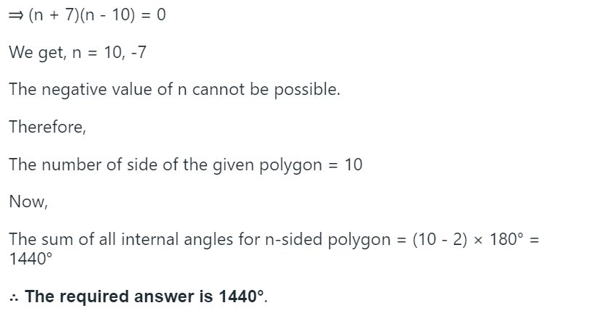
Answer

Slide 11
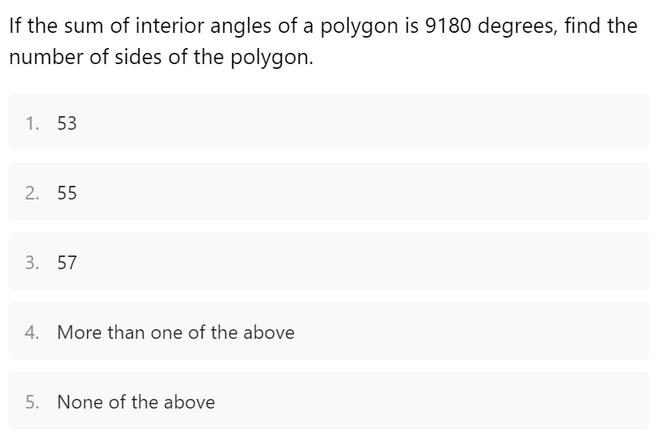
Question
Notes:
Ans: 1) 53

Slide 12
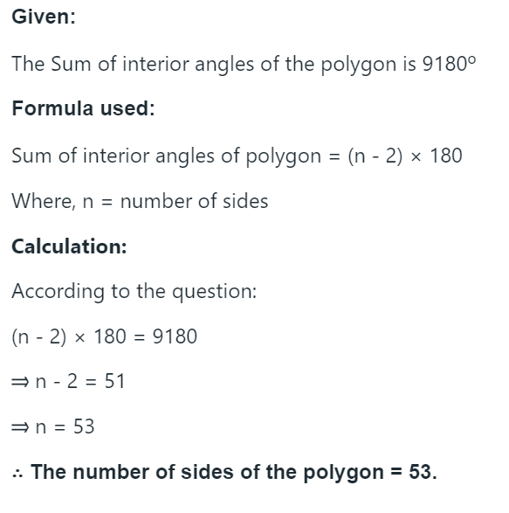
Answer

Slide 13
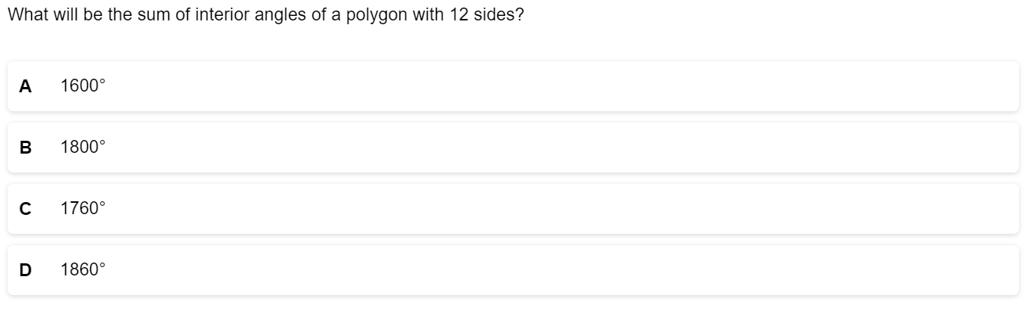
Question
Notes:
Ans: B) 1800
(N-2)*180
(12-2)*180
10*180
1800

Slide 14
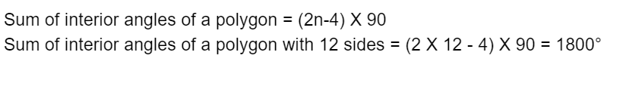
Answer
Notes:
Sum of interior of a polygon = (2n - 4) * 90
Sum of interior of a polygon with 12 sides = (2*12- 4) * 90
=1800 degree

Slide 15
Introduction
1.Sum of the angles of a triangle is 180°.
2.Sum of any two sides of a triangle is greater than the third side.
3.Area of a rectangle = length * breadth.
4.Area of a square = side^² = 1/2(diagonal)^²
5.Area of a circle = π * r*r ; r = radius and π / PI = 22/7 or 3.14
6. Area of a kite: 1/2 * (d)₁ × (d)₂. Here (d)₁ and (d)₂ are long and short diagonals of a kite.
7.Area of a semi circle = π * r * r / 2 ; Circumference = π * r
8.To find the area of a parallelogram, just multiply the base length (b) times the height (h): Area = b * h

Slide 16
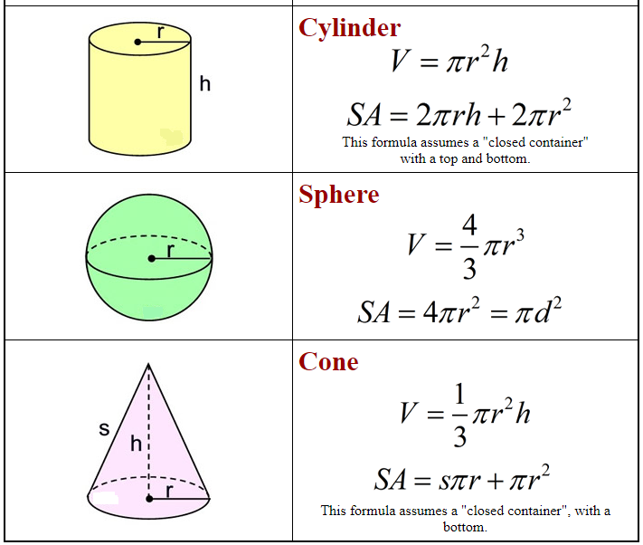
Volume and Surface Area

Slide 17
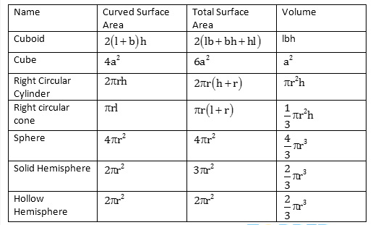
Important Formulas

Slide 18
ANGLES
Angles: An angle is defined as the shape created by two rays intersecting at a common endpoint. The symbol is used to symbolise an angle is “∠” and it is measured in degrees (°).Angles can be categorized based on their measurements. They are:
Acute Angle: Angle < 90°
Right Angle: Angle = 90°
Obtuse Angle: Angle > 90°
Straight Angle: Angle = 180°
Reflex Angle: Angle > 180° and < 360°
Complete Angle: Angle = 360°

Slide 19
Question
A polygon has 44 sides, then the number of its diagonals are ______.
○ 850
○ 877
○ 902
○ None of these
Notes:
ANS:902
The number of diagonals in a polygon with n sides is given by the formula: Diagonals = n(n - 3) / 2
In this case, the polygon has 44 sides (n = 44). So:
Diagonals = 44(44 - 3) / 2
Diagonals = 44(41) / 2
Diagonals = 1804 / 2
Diagonals = 902
Answer: 902
A polygon with 44 sides has 902 diagonals.

Slide 20
Question
Find the sum of all the angles (in degrees) if the polygon has 11 sides.
○ 1620
○ 1540
○ 1230
○ 1830
Notes:
ANS: 1620
To find the sum of the interior angles of an 11-gon, divide it up into triangles... There are nine triangles... Because the sum of the angles of each triangle is 180 degrees... We get 11 hexagons
So, the sum of the interior angles of an 11-gon is 1620 degrees.

Slide 21
Question :
The surface area of a cube whose volume is 27, is ______?
32
54
96
108
Notes:
Ans: b
Solution:
➔ the volume of the cube, V=27
➔ The volume of a cube is given by V = a^3, where a is the side length of the cube.
a^3 = 27 ➔ a = 3
The surface area of a cube is given by 6a^2.
Substituting a = 3:
➔ Surface Area=6×3^2 ➔ 6×9➔ 54

Slide 22
Question :
A triangle is made from a rope. The sides of the triangle are 21 cm, 15 cm, and 32 cm. What will be the area of the square made from the rope? (in cm²)
289
324
400
456
Notes:
Ans: a
The total length of the rope is the sum of the sides of the triangle:
21+15+32=68 cm.
This total length of 68 cm will be the perimeter of the square. The formula for the perimeter of a square is:
4* side length = perimeter
If the rope is reshaped into a square, each side of the square will be:
Side of the square=68/4=17 cm.
The area of the square is:
Area=(Side)^2=17^2=289 cm^2.
the correct answer is 289.

Slide 23
Question :
A rope, length 396 cm, is cut into three equal pieces and each piece is used to make a circle, an equilateral triangle, and a square. Which shape has the largest area?
Square
Circle
Triangle
All are equal
Notes:
Ans: b
Circle: The circumference of the circle is 396/3=132 cm. Using the formula for circumference:
C=2πr
⇒r=C/2π
=132/2π
=66/π cm.
The area of the circle is:
Area of circle=πr^2
=π(66/π)^2
=4356/π cm2.
Square: The perimeter of the square is 132 cm. Each side of the square is:
Side=132/4=33 cm.
The area of the square is:
Area of square=Side^2
=33^2
=1089 cm2.
Triangle: The perimeter of the triangle is 132 . Each side of the equilateral triangle is:
Side=132/3=44 cm.
Using the formula for the area of an equilateral triangle:
Area of triangle=√3/×Side^2
=√3/4×44^2
=√3/4×1936
≈1674.38 cm2.

Slide 24
Question :
The perimeter of a square is equal to the perimeter of a rectangle with a length of 16 cm and a breadth of 14 cm. Find the circumference of a semicircle whose diameter equals the side of the square. (Round off your answer to two decimal places)
77.14 cm
23.57 cm
84.92 cm
94.94 cm
Notes:
Ans: b (but answer 38.57 )
Let side of the square be a.
Perimeter of square = perimeter of rectangle
4a = 2(L + B)
4a = 2 (16 + 14) = 60
a = 15 cm
Diameter of the semicircle = d = 15cm
Circumference of semicircle = pi*d/2 + d
= (1/2 x 22/7 x 15)+15
= 38.57 cm

Slide 25
Question :
Find the area of the triangle formed by the points (2, 3), (4, 5), and (6, 3)
3 sq. units
2 sq. units
4 sq. units
6 sq. units
Notes:
Ans:
Area of triangle = 1/2​* ∣ x1*(y2-y3)+X2*(y3-y1) +X3*(y1-y2) ​∣
= ½ * ​∣ 2*(5-3) + 4*(3-3) + 6*(3-5) ∣
= ½ ∣ 4 + 0 -12 ∣
= ½ * ∣-8​∣
= 4

Slide 26
Question :
Poles are to be created along the boundary of a rectangular field in such a way that the distance between any two adjacent poles is 1.5 metres. The perimeter of the field is 21 metres and the length and the breadth are in the ratio of 4:3 respectively. How many poles will be required?
14
15
16
30
Notes:
Ans: a
Let's assume the length of the rectangular field to be 4x and its breadth to be 3x.
Then, the perimeter of the rectangular field can be calculated as:
Perimeter = 2(Length + Breadth)
21 = 2(4x + 3x)
21 = 14x
x = 1.5 m
Therefore, the length of the rectangular field is 6 m and its breadth is 4.5 m.
Number of poles required = Perimeter / Distance between any two adjacent poles
Number of poles required = 21 / 1.5
Number of poles required = 14
Hence, the correct answer is option A, which is 14 poles.

Slide 27
Question :
The length of a rectangle is reduced by 30%. By what percent would the width have to be increased to maintain the original
area?
25%
42.86%
32.76%
35.5%
Notes:
Ans: b
Original, L= 100
Original length Reduced by 30
New length = 70
Breadth % = 30/70 * 100
= 300/7
= 42.85 %

Slide 28
Question :
A park is in the shape of a right-angled triangle. If the sides (in meters) of that right-angled triangle are three consecutive integers, find the cost of sowing flower seeds in the park at the rate of Rs. 25 per sq. m.
Rs. 150
Rs. 125
Rs. 300
Rs. 250
Notes:
Ans: a
In a right-angled triangle PQR,
PQ^2 + QR^2 = PR^2
The possible values of PQ, QR, and PR are 3, 4,
and 5
The area of the triangle = 1/2 × base × height = ½ * 3 × 4 = 6 m^2
The cost of sowing flower seeds in the park at the rate of Rs. 25 per sq. m = 25 × 6 = Rs. 150

Slide 29
Question :
The ratio between the number of sides of two regular polygons is 1:2, and the ratio between their interior angles is 2:3. The number of sides of these polygons is, respectively:
4, 8
7, 14
6, 12
5, 10
Notes:
Ans: a
Let the number of sides of two regular polygons be x and 2x. Then,
(180 deg – 360 deg/x) : ( 180 – 260/2x) = 2:3
((180 * x – 360) / x ) : ((180*2x - 360) / 2x) = 2 : 3
(180(x-2)) / x : (360(x-1)) / 2x = 2 : 3
180(x-2)/x * 2x / 360(x-1) = 2/3
X-2/x-1 = 2/3
3x -6 = 2x -2
X = 4
2x = 2* 4 = 8

Slide 30
Question :
The area of a trapezium is 1586 cm², and the distance between its parallel sides is 26 cm. If one of the parallel sides is 84 cm, find the other.
38
39
40
41
Notes:
Ans: a
Area of trapezium = 1586 cm^2
Perpendicular distance = 26 cm
Length of one side = 84 cm
Area of trapezium = 1/2 x (Sum of parallel sides) x (Height)
assume that another side is 'a’ cm
Area of trapezium = 1/2 x (Sum of parallel sides) x (Height)=1586
=1/2×(a +84)x 26
= 122 = 84 + a
= a = 38 cm.
The another side is 38 cm

Slide 31
Question :
The area of the square formed on the diagonal of a rectangle as its side is 108 1/3 % more than the area of the rectangle. If the perimeter of the rectangle is 28 units, find the difference between the sides of the rectangle.
8
12
6
2
Notes:
Ans: d
Let the sides of the rectangle be a and b.
Perimeter = 28
2(l + b) = 28
L + b = 14
The area of the rectangle is A = ab. The area of the square on the diagonal is (a^2 + b^2)
Given that,
Area of square on diagonal = area of rectangle + 108(1/3) % of area of rectangle
a^2 + b^2 = ab +108.33/100 ab
a^2 + b^2 = 2.0833 ab
Use the identity,
a^2 + b^2 = (a+b)^2 - 2ab
(14)^2 - 2ab = 2.0833ab
196 - 2ab = 2.0833ab
196 = 4.0833ab
ab ​≈ 48.0
solve a+b = 14 and ab ≈ 48 using x^2 - 14x + 48 = 0
The roots are x = 6 and x=8.
The difference |8 - 6| = 2

Slide 32
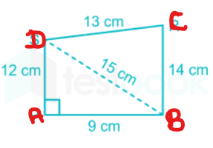
Question :
The base of a right prism is a quadrilateral ABCD, given that AB=9cm,BC=14 cm, CD=13 cm, DA=12 cm, and ∠DAB=90∘. If the volume of the prism is 2070 cm^3, then what is the area of the lateral surface?
720 cm^2
810 cm^2
1260 cm^2
2070 cm^2
Notes:
Ans: a
ab = 9 cm, bc = 14 cm, cd = 13 cm, da= 12 cm and ∠dab = 90°
DB^2 = DA^2 + AB^2
=> DB^2 = 12^2 + 9^2 = 225
=> DB = 15 cm
Area of △ ABD = (1/2) x 12 x 9 = 54cm^2
In △ CBD
s = (13 + 14 + 15)/2 = 21
Area of △ CBD = √[21 x (21-13) x(21-14)x(21-15)]
√ [21×8×7x6]
√7056
84 cm^2
Area of quadrilateral ABCD = 54 + 84 = 138 cm^2
Area of the base = 138 cm^2
Since volume of the prism is 2070 cm3
2070 = 138 x height
Height = 2070/138
15 cm
So, Lateral surface area of the prism = (Base perimeter) x height
(9 + 12 +13+14) * 15
720 cm^2

Slide 33
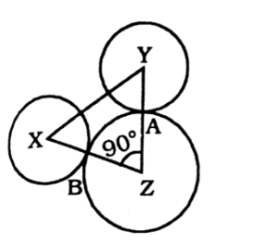
Question :
X and Y are centers of circles of radii 9 cm and 2 cm respectively.
XY =17 cm. Z is the center of a circle with a radius of ‘r’ cm that touches the above circles externally. Given that ∠XZY=90∘, the value of ‘r’ is:
6 cm
8 cm
9 cm
13 cm
Notes:
Ans:
XZ =r + 9
:. XY^2 = xz^2 + ZY^2
17^2 = (r+9)^2 + (r + 2)^2
289 = r^2 + 18r + 81 + r^2 + 4r + 4
2r^2 + 22r + 85 - 289 = 0
2r^2 +22r - 204 = 0
R^2 + 11r - 102 = 0
R^2 + 17r -6r-102 = 0
r(r+ 17) -6(r+ 17) = 0
(r - 6) (r+17) = 0
r = 6 cm

Slide 34
Question :
The radius of a wheel is 22.4 cm. What is the distance covered by the wheel in making 500 revolutions?
252 m
704 m
352 m
808 m
Notes:
Ans: b
In one resolution, the distance covered by the wheel is its own circumference. Distance covered in 500 resolutions.
= 500 * 2 * 22/7 * 22.4
= 70400 cm
= 704 m

Slide 35
Question :
The length of a rectangular floor is more than its breadth by 200%. If ₹324 is required to paint the floor at the rate of ₹3 per sq. meter, then what would be the length of the floor?
27m
24m
18m
21m
Notes:
Ans: c
Let the length and the breadth of the floor be L and B respectively.
L = B + 200% of B
L = B + 2B = 3B
Area of the floor = 324/3 = 108 sq m
L*B = 108
i.e., L * L/3 = 108
L^2 = 324
L = 18

Slide 36
Question :
The sum of the circumference of a circle and the perimeter of a rectangle is 480 cm. If the area of the rectangle is 168 cm² and the ratio of the radius of the circle to the breadth of the rectangle is 19:2, find the area of another circle whose radius is 28% of the diagonal of the rectangle. (Note: Length and Breadth of the rectangle must be integers.)
343 cm²
154 cm²
189 cm²
350 cm²
Notes:
Ans: b
Length and breadth of a rectangle are I cm and b cm.
given that the radius of the circle and the breadth of the rectangle are 19X and 2X respectively.
According to the question,
Length * breadth = 168 L x 2X = 168
L = 84/X cm
2TTr + 2(l + b) = 480
22/7 x (19X) + (84/X+2X)=240
36X^2 -140X +49 = 0
X= 7/2
So, the length and breadth of the rectangle are 24cm and 7 cm.
So, diagonal of the rectangle = √24^2+7^2
=25 cm.
Radius (R) of new circle which is 28% diagonal of rectangle = 25 x (28/100) = 7 cm
Area of circle = TTr2= 22/7 ×7×7 = 154 cm^2

Slide 37
The radius of the cone is 10 cm. The ratio of the curved surface area to the total surface area of the cone is 4:5. Find the slant height of the cone.
30 cm
40 cm
35 cm
42 cm
Notes:
Ans”: b
Radius r=10r=10 cm
Ratio of CSA to TSA = 4:5
Curved Surface Area (CSA) of a cone: πrl
Total Surface Area (TSA) of a cone: πrl+πr^2
πrl / πrl +πr^2​= 4/5​
r=10 cm:
π×10×l /π×10×l​+π×10^2=4/5​
10l / 10l+100 = 4/5
​
5×10l=4×(10l+100)
50l=40l+400
50l−40l=400
10l=400
l=40
The slant height of the cone is 40cm.

Slide 38
Question :
In a circle, a chord of length 10 cm is 6 cm away from the center. Find the radius.
a) 8 cm
b) 10 cm
c) 12 cm
d) 14 cm
Notes:
Ans: a
R^2=6^2+5^2
r^2 = 61
R = √61
R =7.82
R =~8

Slide 39
THANK YOU

